Slide 1

Data Science For Business
January 2025
Module 3 – Fitting, Overfitting, Generalization

Slide 2
Quiz time!

Slide 3
Quiz discussion!

Slide 4
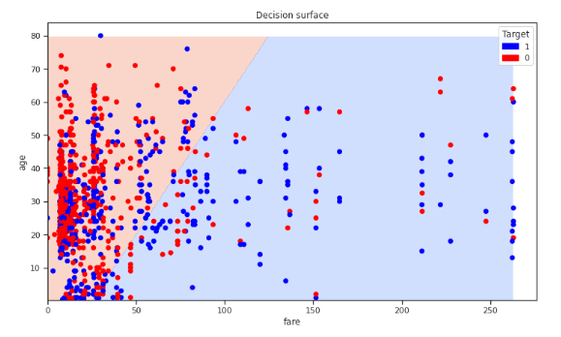
Q1
1
0
age = 70, fare = 200

Slide 5
Q1
1
0
age = 70, fare = 200

Slide 6
Q2
1
0
age = 30, fare = 50

Slide 7
Q2
1
0
age = 30, fare = 50

Slide 8
Q3
1
0
age = 10, fare = 0

Slide 9
Q3
1
0
age = 10, fare = 0

Slide 10
Q4
1
0
age = 5, fare = 50

Slide 11
Q4
1
0
age = 5, fare = 50

Slide 12
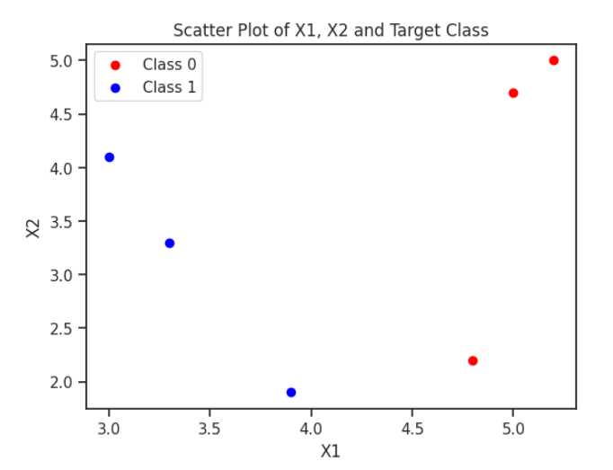
Q5
What is the current entropy without any splits? Please use 1 significant digit.
We are now going to create a SINGLE SPLIT (depth = 1) decision tree

Slide 13
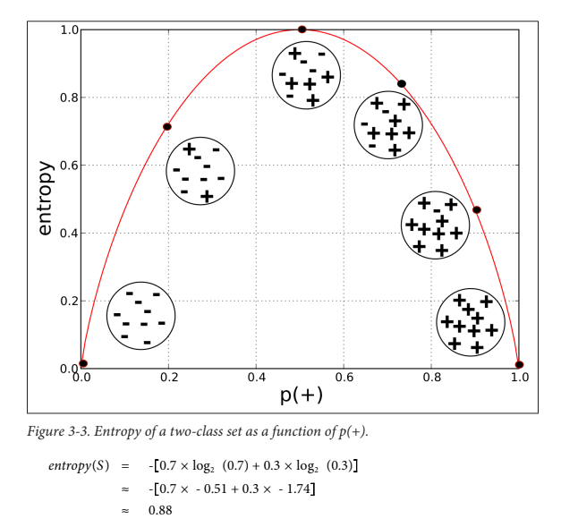
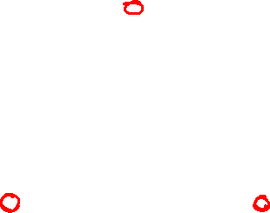
Q5
What is the current entropy without any splits? Please use 1 significant digit.
We are now going to create a SINGLE SPLIT (depth = 1) decision tree

Slide 14
Q5
What is the current entropy without any splits? Please use 1 significant digit.
1.0 (totally mixed up)
We are now going to create a SINGLE SPLIT (depth = 1) decision tree

Slide 15
Q6
Which feature (X1 or X2) should we split on to maximize information gain (i.e. create the most predictive split)?
We are now going to create a SINGLE SPLIT (depth = 1) decision tree

Slide 16
Q6
Which feature (X1 or X2) should we split on to maximize information gain (i.e. create the most predictive split)?
X1
We are now going to create a SINGLE SPLIT (depth = 1) decision tree

Slide 17
Q7
What threshold should be picked for this feature to maximize information gain?
We are now going to create a SINGLE SPLIT (depth = 1) decision tree

Slide 18
Q7
What threshold should be picked for this feature to maximize information gain?
~4
We are now going to create a SINGLE SPLIT (depth = 1) decision tree

Slide 19
Q8
What is the entropy of each leaf node (each sub-group) after this split?
We are now going to create a SINGLE SPLIT (depth = 1) decision tree

Slide 20
Q8
What is the entropy of each leaf node (each sub-group) after this split?
0 for X1<4.0 and 0 for X1 >= 4.0
We are now going to create a SINGLE SPLIT (depth = 1) decision tree

Slide 21
Q9
What is the entropy of each leaf node (each sub-group) after this split?
0 for X1<4.0 and 0 for X1 >= 4.0
We are now going to create a SINGLE SPLIT (depth = 1) decision tree

Slide 22
Q9
What is the information gain of this split?
We are now going to create a SINGLE SPLIT (depth = 1) decision tree

Slide 23
Q9
What is the information gain of this split?
1.0
We are now going to create a SINGLE SPLIT (depth = 1) decision tree

Slide 24
Agenda
Week 1
Module 1 (Thursday): Intro to data science + Python for DS
Module 2 (Friday): Intro to supervised learning
Week 2
Module 3 (Monday): Fitting models, generalization
Module 4 (Tuesday): Regularization
Module 5 (Wednesday): Evaluation (ROC, cost visualization)
Module 6 (Thursday): Modeling text data
Week 3
Module 7 (Monday): Neural networks, GenAI
Module 8 (Tuesday): Guest lecture(s)
Module 9 (Wednesday): Causal inference, AB testing, wrap up
Final Exam (Thursday)

Slide 25
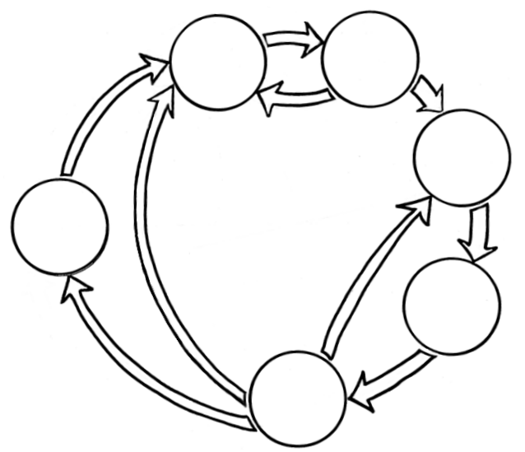
Where we are
Business Understanding
Data Understanding
Data Preparation
Data Science
Process
Deployment
Modeling
Evaluation

Slide 26

Where we are
Business Understanding
Data Understanding
Last class
Data Preparation
Data Science
Process
Deployment
Modeling
Evaluation

Slide 27
Where we are
Last class
Goal: Build a predictive model to predict whether a given person will survive the titanic

Slide 28
Where we are
Last class
Goal: Build a predictive model to predict whether a given person will survive the titanic
Solution: Decision Trees
Notes:
Last class: we built our first ML model
Perks of decision trees is that they are easily understandable and can model complex data (by making more splits)

Slide 29
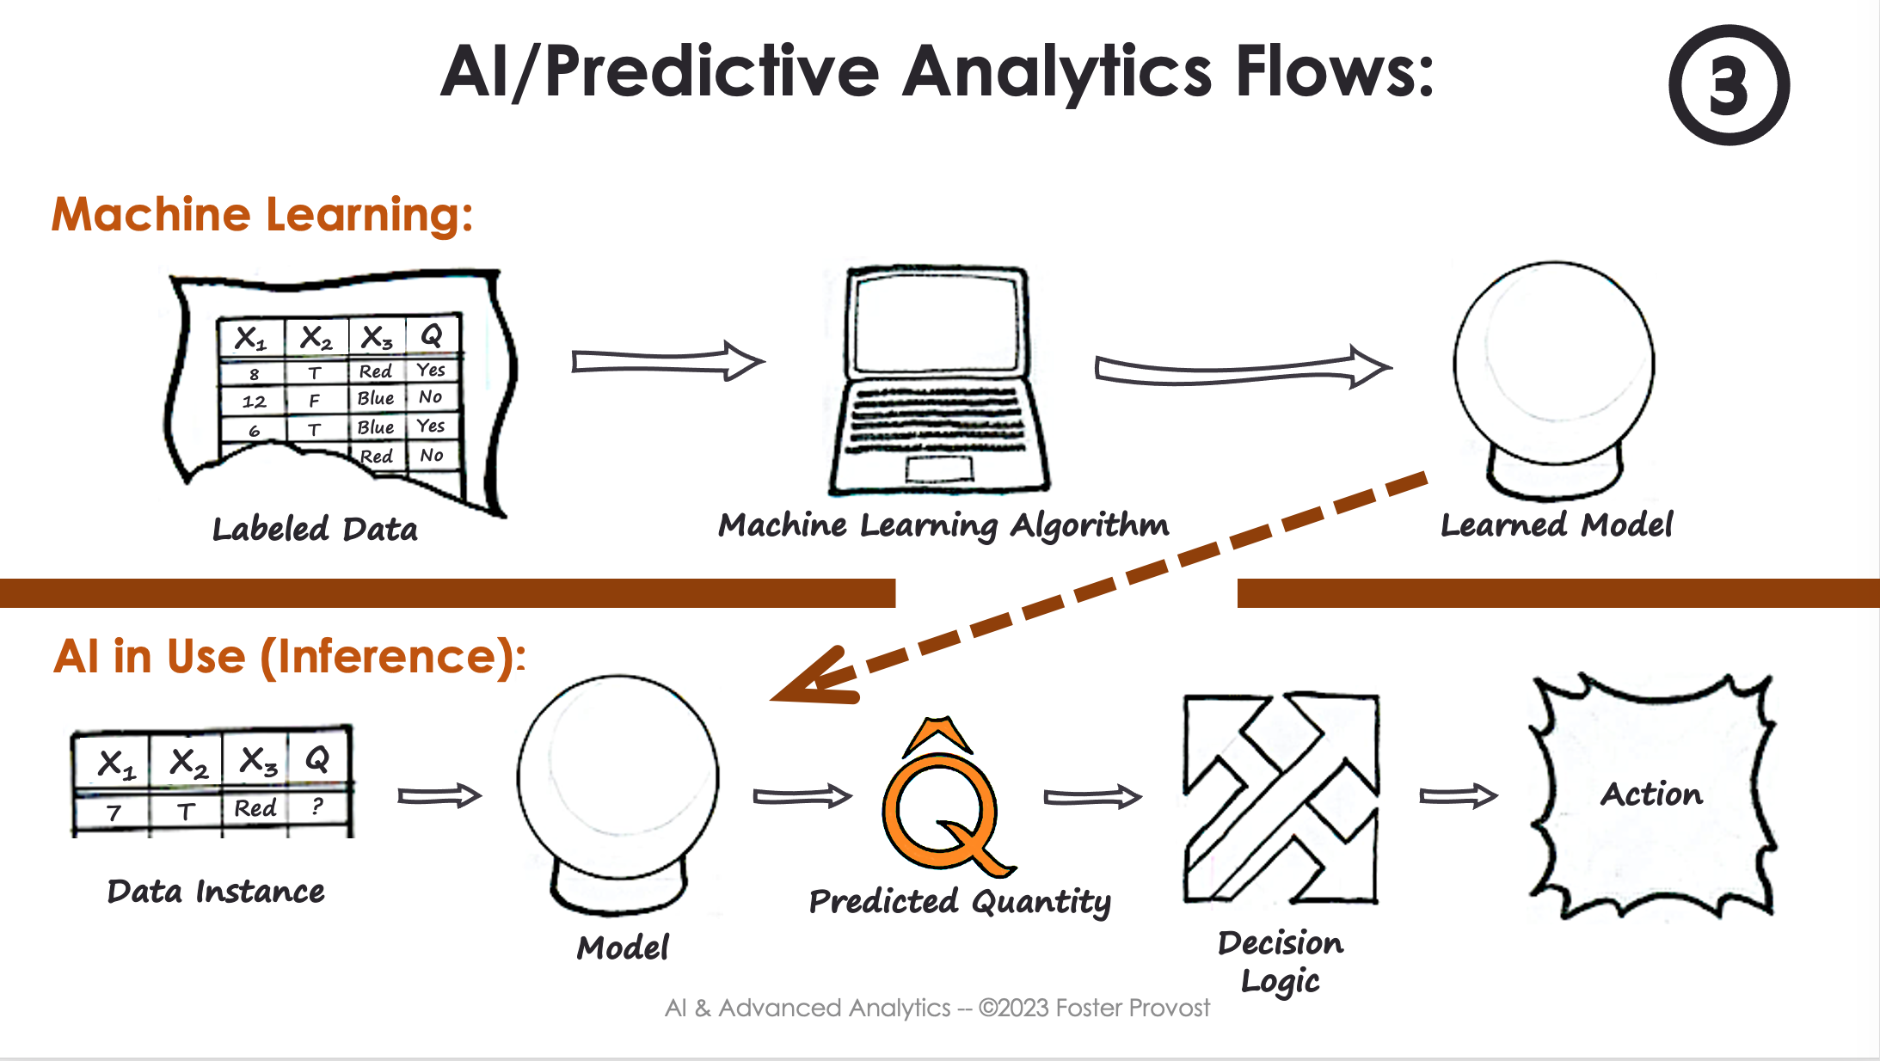

Where we are
Last class

Slide 30

Where we are
Titanic:
Features (inputs) = attributes about passengers (class, fare, sex, etc.)
Target (quantity to predict) = Survive (yes = 1/ no = 0)
Last class

Slide 31
Where we are
Titanic Survival Data
Last class
Make Splits on Information Entropy (H)

Slide 32
Where we are
Titanic Survival Data
Last class
Make Splits on Information Entropy (H)
Decision Tree

Slide 33
Where we are
Last class
In doing this, we find the subsets of feature values (e.g. female = 1 & class = 1.0) that correlate with high probability of survival ( or not survival)

Slide 34
Where we are
Last class
We can then use this learned model to predict whether someone will survive if we don’t have this information

Slide 35
Where we are
Last class
We can then use this learned model to predict whether someone will survive if we don’t have this information
New person (instance) with feature values
but no target value

Slide 36
Where we are
Last class
We can then use this learned model to predict whether someone will survive if we don’t have this information
New person (instance) with feature values
but no target value
Decision Tree

Slide 37
Where we are
Last class
We can then use this learned model to predict whether someone will survive if we don’t have this information
New person (instance) with feature values
but no target value
Decision Tree
Survive = {0,1} or P(Leaf of instance that survived)

Slide 38
Where we are
Last class
We can then use this learned model to predict whether someone will survive if we don’t have this information
New person (instance) with feature values
but no target value
Decision Tree
If P(survive)<.5 → Predict WILL NOT survive
Survive = {0,1} or P(Leaf of instance that survived)

Slide 39
Where we are
Last class
We can then use this learned model to predict whether someone will survive if we don’t have this information
New person (instance) with feature values
but no target value
Add extra life vests to rooms of people not predicted to survive?
Decision Tree
If P(survive)<.5 → Predict WILL NOT survive
Survive = {0,1} or P(Leaf of instance that survived)

Slide 40
Where we are
Last class
Goal: Build a predictive model to predict whether a given person will survive the titanic

Slide 41
Where we are
Last class
Goal: Build a predictive model to predict whether a given person will survive the titanic
Solution: Decision Trees
Notes:
Now that we’ve seen our fist kind of DS problem, let’s start to place in this in the broader landscape of DS problems

Slide 42
Where we are
Last class
Goal: Build a predictive model to predict whether a given person will survive the titanic (Classification)
Solution: Decision Trees

Slide 43
Where we are
Last class
Types of Tasks and Models

Slide 44
Where we are
Last class
Types of Tasks and Models
Supervised Learning
(?)
Classification / Probability Estimation
Decision tree

Slide 45
Where we are
Last class
Types of Tasks and Models
We have some target value in training data but not in test data
Supervised Learning
(?)
Classification / Probability Estimation
Decision tree

Slide 46
Where we are
Last class
Types of Tasks and Models
Supervised Learning
(?)
We want to predict some class for an instance (e.g. survive/ churn/ purchase)
Classification / Probability Estimation
Decision tree

Slide 47
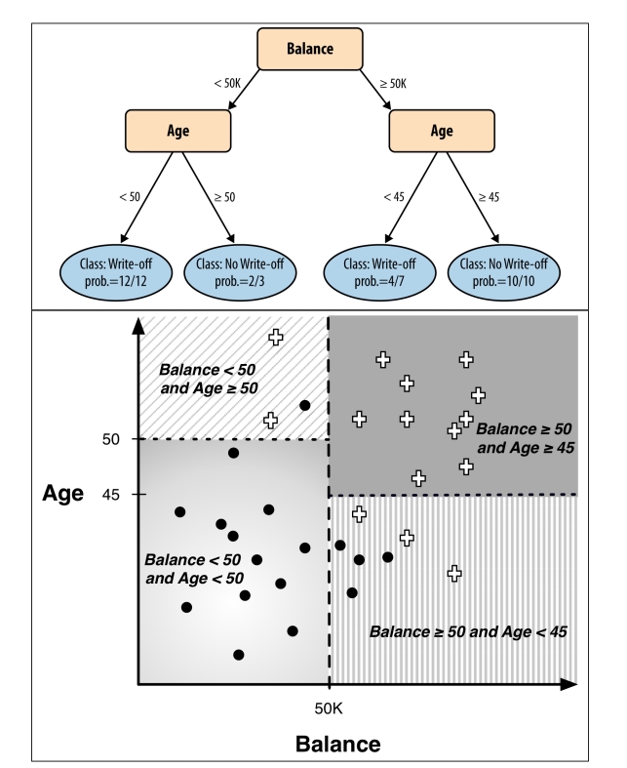
Where we are
Last class
Types of Tasks and Models
Supervised Learning
(?)
Split on class entropy to maximize information gain/ minimize uncertainty
Classification / Probability Estimation
Decision tree

Slide 48
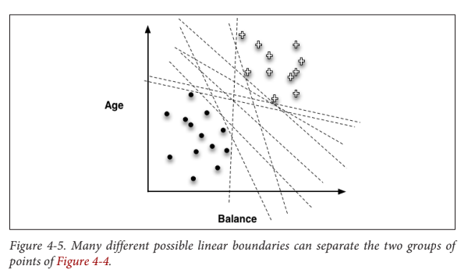
Where we are
Last class
Types of Tasks and Models
Supervised Learning
(?)
Classification / Probability Estimation
Find the line that minimizes some loss function (e.g. sum of misclassified points)
Decision tree
Linear separator (briefly)

Slide 49
Where we are
Today
Types of Tasks and Models
Supervised Learning
(?)
Classification / Probability Estimation
Decision tree
Linear separator (briefly)
Regression
Find the line/polynomial the minimizes some loss function
Linear/polynomial regression
Notes:
Now today we’ll be doing some more kinds of tasks and models and using these to illustrate more general considerations for evaluation of models

Slide 50
Where we are
Today
Types of Tasks and Models
Supervised Learning
(?)
Classification / Probability Estimation
Decision tree
Linear separator (briefly)
Regression
Linear/polynomial regression
Regression tree
Assigns predicted value to all items in a leaf node

Slide 51
Where we are
Today
Specifically, we’re going to use regression (mostly) to illustrate the ideas of fitting and generalization
Regression
Linear/polynomial regression
Regression tree

Slide 52
Where we are
Business Understanding
Data Understanding
Today
Data Preparation
Data Science
Process
Deployment
Modeling
Evaluation

Slide 53


Where we are
Business Understanding
Data Understanding
Today
Data Preparation
Data Science
Process
Deployment
Modeling
Evaluation

Slide 54
Driving Question
Today
What do we want our model to work well on?

Slide 55
Driving Question
Today
What do we want our model to work well on?
Labeled Training Data
(Has Target Value)
Unlabeled Data At Inference Time
(No Target Value)
OR

Slide 56

Driving Question
Today
What do we want our model to work well on?
Labeled Training Data
(Has Target Value)
Unlabeled Data At Inference Time
(No Target Value)
OR

Slide 57

Driving Question
We’ll talk about how we precisely define “work well” in a few classes
Today
What do we want our model to work well on?
Labeled Training Data
(Has Target Value)
Unlabeled Data At Inference Time
(No Target Value)
OR

Slide 58
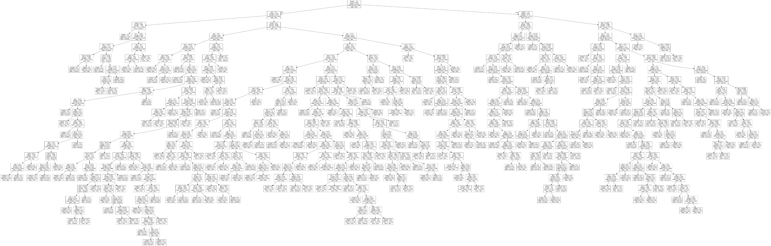
BIG Decision Trees
Consider a tree model. How do we assess how good it is?
Easiest measure – accuracy – how many are correct?
If we apply accuracy to trees built on the training set …
the biggest tree will always be best!
In fact, you can often build a tree with 100% accuracy on the training set
But, our goal is to generalize to data we have not seen yet
Notes:
How is this possible?

Slide 59
Notebook time!

Slide 60

Building Your Toolbox
Business Understanding
Data Understanding
Types of Tasks and Models
Data Preparation
Supervised Learning
Data Science
Process
Classification / Probability Estimation
Deployment
Decision tree
Linear separator/ logistic regression
Modeling
Regression
Linear/polynomial regression
Regression tree
Evaluation

Slide 61

Building Your Toolbox
Business Understanding
Data Understanding
Evaluation Techniques/Considerations
Data Preparation
Data Science
Process
Overfitting (the training data) → worse generalization (on unseen data)
K-fold cross-validation is a way to evaluate generalization
Fitting curves help us evaluate generalization (performance metric across model complexity)
Deployment
Modeling
Evaluation

Slide 62
Assignment time!

